Slide 1
Applied Physics NS (101)
LECTURE # 6&7
DATE: 6TH OCTOBER , 2019

Slide 2
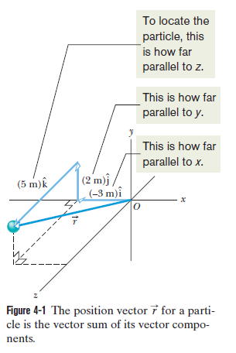
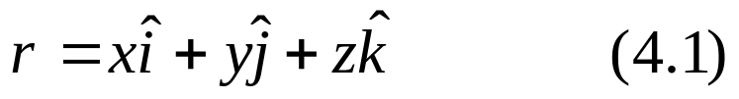

Motion in two/three dimensions
Position and Displacement
One general way of locating a particle (or particle-like object) is with a position
vector , which is a vector that extends from a reference point (usually the
origin) to the particle.
where x , y , and z are the vector components of
and the coefficients x, y, and z are its scalar
components.

Slide 3
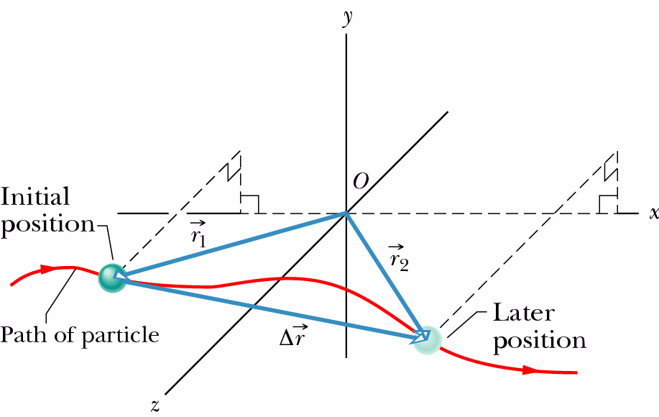
Position and Displacement
Position vector: extends from the origin of a coordinate system to the particle.
Displacement vector: represents a particle’s position change during a certain
time interval.

Slide 4


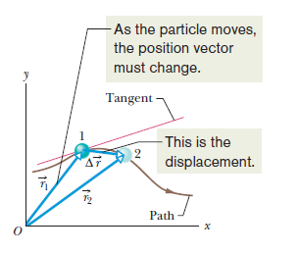

Average Velocity and Instantaneous Velocity
Average velocity:

Slide 5


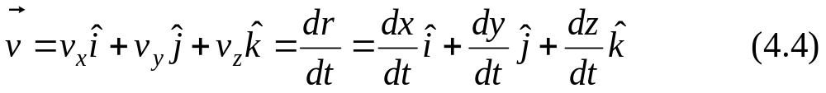
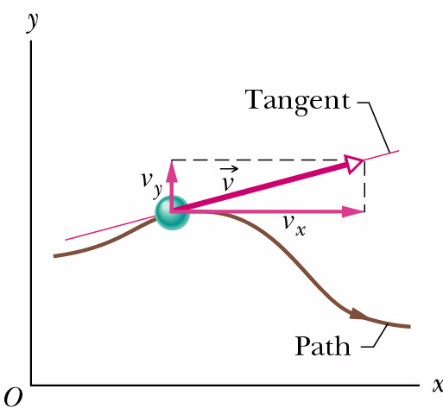
Instantaneous velocity:
The direction of the instantaneous velocity of a
particle is always tangent to the particle’s path at
the particle’s position

Slide 6
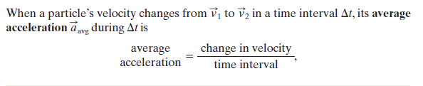
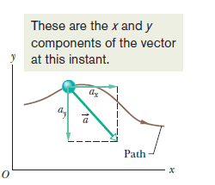
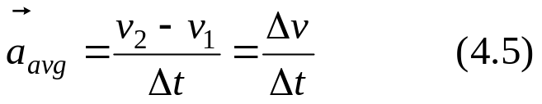
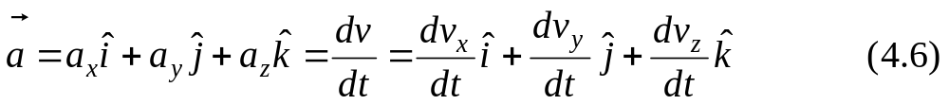
Average acceleration:
Instantaneous acceleration:

Slide 7


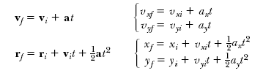

Slide 8
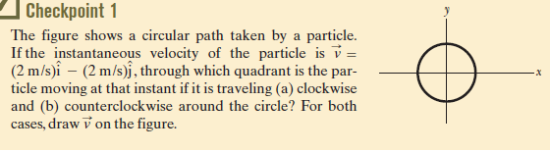
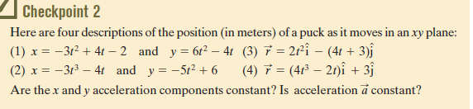

Slide 9
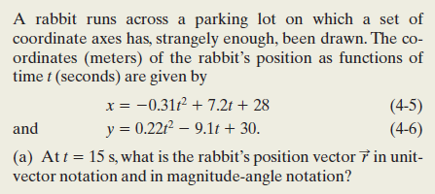



Example

Slide 10
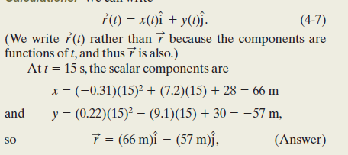
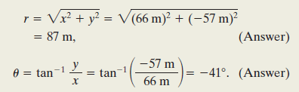

Slide 11
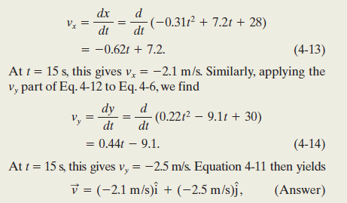
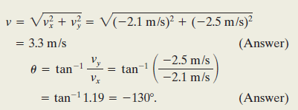

Slide 12
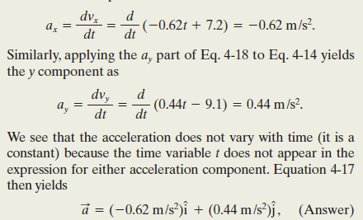
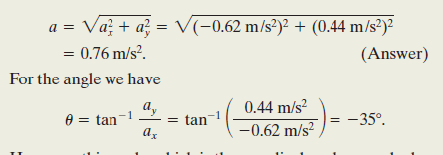

Slide 13

Free Fall and Gravitational Acceleration
A free-falling object is one which is falling under the sole influence of gravity. This definition of free fall leads to two important characteristics about a free-falling object:
  Free-falling objects do not encounter air resistance
  All free-falling objects (on Earth) accelerate downwards at a rate of -9.8 m/s²
    This rate is commonly referred to as g

Slide 14
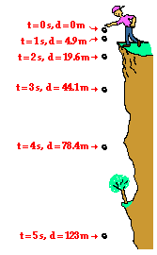
Free Fall and Gravitational Acceleration
All of the equations that work for HORIZONTAL (x-direction) motion ALSO work for VERTICAL (y-direction) motion.
Simply substitute g for a and Δy for Δx
Generally, free falling objects start falling from rest, so it tends to simplify the equations by eliminating v_{i}

Slide 15
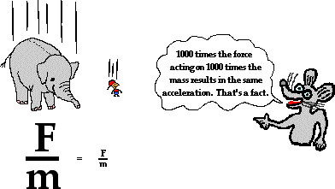
FREELY FALLING OBJECTS
A free-falling object is an object which is falling under the sole influence of gravity. Any object which is being acted upon only be the force of gravity is said to be in a state of free fall.
There are two important motion characteristics which are true of free-falling objects:
Free-falling objects do not encounter air resistance.
All free-falling objects (on Earth) accelerate downwards at a rate of 9.8 m/s/s

Slide 16
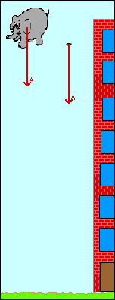


Slide 17
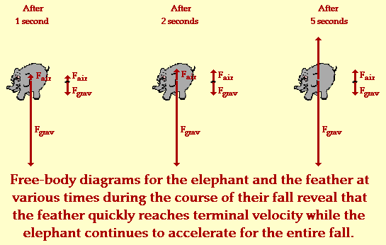

Slide 18
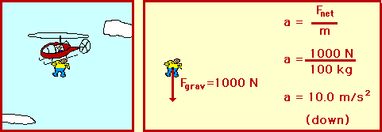
Terminal Velocity
Forces cause objects to accelerate (2nd Law).
When the force of gravity on a falling object equals the force of the air resistance going against gravity, the forces balance out and the object stops accelerating.
The object will travel at a constant velocity – the terminal velocity.

Slide 19
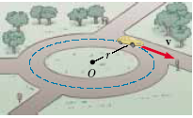


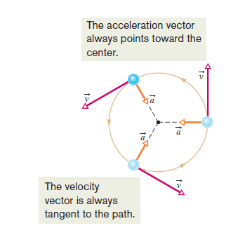
UNIFORM CIRCULAR MOTION
The acceleration vector in uniform circular motion is always perpendicular to the path and always points toward the center of the circle. An Acceleration of this nature is called a centripetal (center-seeking) acceleration, and its magnitude is
Consider a particle moving along a curved path where the velocity changes both in direction and in magnitude

Slide 20

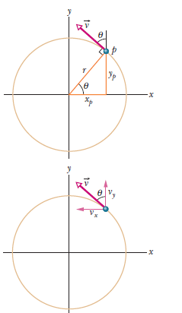





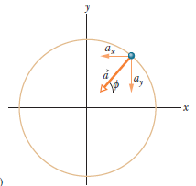
replace sin with yp/r and cos with xp/r

Slide 21

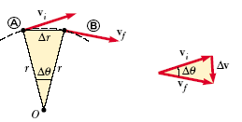

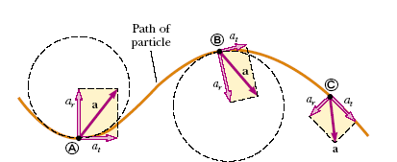
Tangential and Radial Acceleration

Slide 22

Projectile Motion
Two-dimensional motion of an object
  Vertical
  Horizontal

Slide 23

Types of Projectile Motion
Horizontal
  Motion of a ball rolling freely along a level surface
  Horizontal velocity is ALWAYS constant
Vertical
  Motion of a freely falling object
  Force due to gravity
  Vertical component of velocity changes with time
Parabolic
  Path traced by an object accelerating only in the vertical direction while moving at constant horizontal velocity

Slide 24
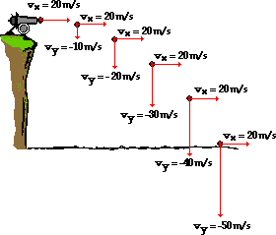
Examples of Projectile Motion
Launching a Cannon ball

Slide 25
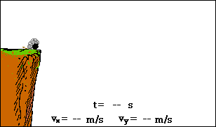
Final Horizontal and Vertical component of velocity: vxf = v Cosθ vyf = v Sinθ -gt
The projectile motion is the superposition of two motions:
constant velocity motion in the horizontal direction and
free-fall motion in the vertical direction.

Slide 26

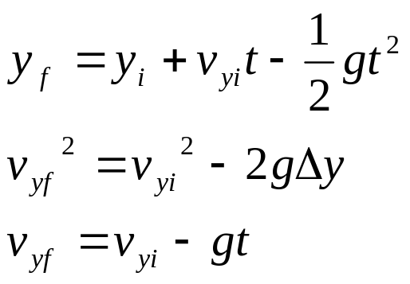
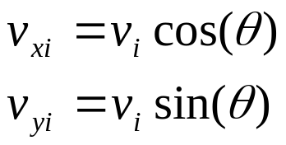
Equations
X- Component
Y- Component
Vectors
Note: g= 9.8 m/s^2

Slide 27


Slide 28




The Horizontal Motion
There is no acceleration in the horizontal direction, the horizontal component vx of the projectile’s velocity remains unchanged from its initial value v0x throughout the motion
a = 0
The Vertical Motion
In vertical the acceleration is constant i.e
a = -g

Slide 29

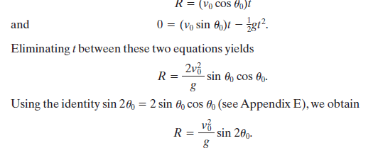
The Equation Path
The path of a projectile, which we call its trajectory, is always a parabola
The Horizontal Range
The horizontal range R of the projectile is the horizontal distance the projectile
has traveled when it returns to its initial height (the height at which it is
launched). To find range R, let us put x - x0 = R and y - y0 = 0

Slide 30

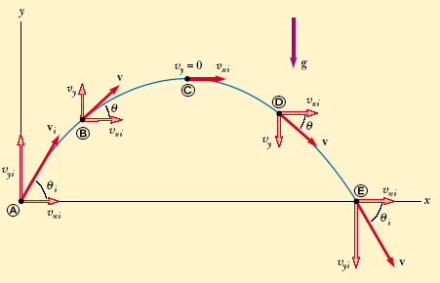
Maximum Height

